Slide 1
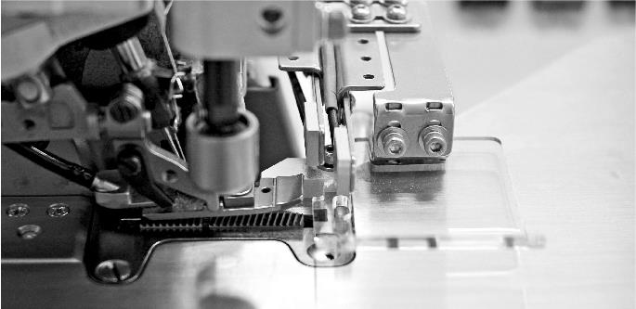

2024 Presentation
2024/11/28

Slide 2
Agenda
1 | Kaulin Introduction | 14: 30 ~ 15:00
2 | Q & A | 15: 00 ~ 15:30

Slide 3
Disclaimer
The information contained in this presentation, including all forward-looking information, is subject to change without notice, whether as a result of new information, future events or otherwise, and Kaulin Manufacturing Co., Ltd. (the “Company”) undertakes no obligation to update or revise the information contained in this presentation. No representation or warranty, either expressed or implied, is provided in relation to the accuracy, completeness or reliability of the information contained herein, nor is the information intended to be a complete statement of the Company, markets or developments referred to in this presentation.

Slide 4


1. Company Overview
Establishment: Oct. 1965 (TW 1531)
Capital: 56 M USD (1.82 B NTD)
Product: Industrial sewing machine
Brand:
Employees: Taiwan 109 ppl (Group 382 ppl)
Headquarter: Taipei, Taiwan
Subsidiary | Miami, U. S. A. / Hanoi, Vietnam
Agents | Europe/ Africa/ Asia/ America, 90 countries
R & D, Production | Taoyuan, Taiwan / Ningbo, China

Slide 5
2. Operation Performance
2024 3Q Consolidated Income Statement
Changes in Net Sales
Products mix
Changes in Net Income
2024 3Q Consolidated Balance Sheet
2024 3Q Consolidated Statement of cash flows

Slide 6
2024 3Q Consolidated Income Statement
Consolidated Income Statement (NTD Million) | 2024 3Q | 2023 3Q | YoY | 2024 3Q YTD | 2023 3Q YTD | YoY
Operating revenue | 431 | 360 | 19.7% | 1,241 | 1,102 | 12.6%
Operating costs | 339 | 325 |  | 1,003 | 951
Gross profit from operations | 92 | 35 | 162.9% | 238 | 150 | 58.7%
Operating expenses | 65 | 52 | 24.0% | 233 | 245 | -4.9%
Selling expenses | 26 | 27 |  | 74 | 74
Administrative expenses | 25 | 12 |  | 123 | 138
R&D expenses | 14 | 13 |  | 36 | 33
Net operating income | 27 | (16) | 268.8% | 5 | (94) | 105.6%
Total non-operating income and expenses | (9) | 47 |  | 63 | 87
Foreign exchange gains | (25) | 31 |  | 19 | 45
Other gains and losses | 16 | 16 |  | 44 | 42
Profit (loss)before tax | 18 | 30 | -40.0% | 68 | (6) | 1179.4%
Total tax expense | 5 | 13 |  | 15 | 11
Profit (loss) from discontinued operations | (2) | 66 |  | (8) | 59
Profit (loss) | 12 | 84 | -85.7% | 45 | 41 | 9.8%
Earnings per share | 0.06 | 0.46 | (0.40) | 0.25 | 0.23 | 0.02
Gross Margin % | 21.3% | 9.7% | 11.6% | 19.2% | 13.6% | 5.6%
Operating Margin % | 6.3% | -4.4% | 10.7% | 0.4% | -8.5% | 9.0%
Net Margin % | 2.8% | 23.3% | -20.5% | 3.6% | 3.7% | -0.1%
Op. Exp % | 15.0% | 14.4% | 0.5% | 18.8% | 22.2% | -3.5%

Slide 7
Changes in Net Sales
(including discontinued operations)
(NTD Mil)

Slide 8
Sales Mix (by Region)

Slide 9
Sales Mix (by Product)

Slide 10
Gross profit increased due to sales increased, and products mix.
合併淨利同比分析
(NTD Mil)
P/L decreased from discon. Op. due to sale of warehouse in 2023.
P/L
YOY
+4 Mil
N/O Income decreased due to less Forex profit.

Slide 11
2024 3Q Consolidated Balance Sheet
Consolidated Balance Sheet (NTD Million) | 2024/9/30 | 2023/9/30 | YoY
Cash and cash equivalents | 1,027 | 822 | 205.0
Current financial assets at amortised cost | 325 | 234 | 91.0
Accounts receivables | 624 | 655 | (31.0)
Inventories | 796 | 1,062 | (266.0)
Total current assets | 3,051 | 3,043 | 8.0
Investment property | 194 | 196 | (2.0)
Property, plant and equipment | 849 | 892 | (43.0)
Total assets | 4,314 | 4,290 | 24.0
Short-term borrowings | 100 | 100 | 0.0
Accounts payables | 236 | 262 | (26.0)
Total current liabilities | 392 | 393 | (1.0)
non-current liabilities | 264 | 226 | 38.0
Total liabilities | 656 | 619 | 37.0
Ordinary share | 1,821 | 1,836 | (15.0)
retained earnings | 1,729 | 1,754 | (25.0)
Total equity | 3,658 | 3,671 | (13.0)
Quick Ratio | 778% | 774% | 4%
Current Ratio | 504% | 435% | 69%
Debt Ratio | 15% | 14% | 1%
ROE (YTD Annualized) | 1.6% | 1.5% | 0.1%

Slide 12
2024 3Q Consolidated Statement of cash flows
Consolidated Statement of cash flows (NTD Million) | 2024 3Q YTD | 2023 3Q YTD
Cash inflow (outflow) generated from operations | 308 | 219
Net cash flows from (used in) investing activities | 12 | (272)
Net cash flows from (used in) financing activities | (37) | (300)
Effect of exchange rate changes on cash and cash equivalents | 8 | 5
Net increase (decrease) in cash and cash equivalents | 290 | (348)
Cash and cash equivalents at beginning of period | 737 | 1,170
Cash and cash equivalents at end of period | 1,027 | 822
Remarks：
Depreciation & Amortization expense | 58 | 55

Slide 13
3. Development Strategy
Continuous enhancement of corporate constitution
  Quality is corporate priority
  Organization activation / Technology inheritance
  New Tools / new techniques apply
Enterprise transformation
  Fully implement ESG sustainable management strategy
  Expand the value promotion strategy map
  Committed to electronic control and IoT capabilities
Continual optimization of business model
  Improve the cost performance of the main products
  Balance of homemade and outsourcing
  Automation and customized orders
Long-term competitive advantage
  Strategic alliance：reinforcement
  Joint venture／Mergers and Acquisitions：upstream and downstream, different industry

Slide 14
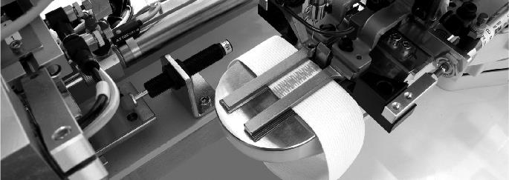
02
Q & A

